Slide 1
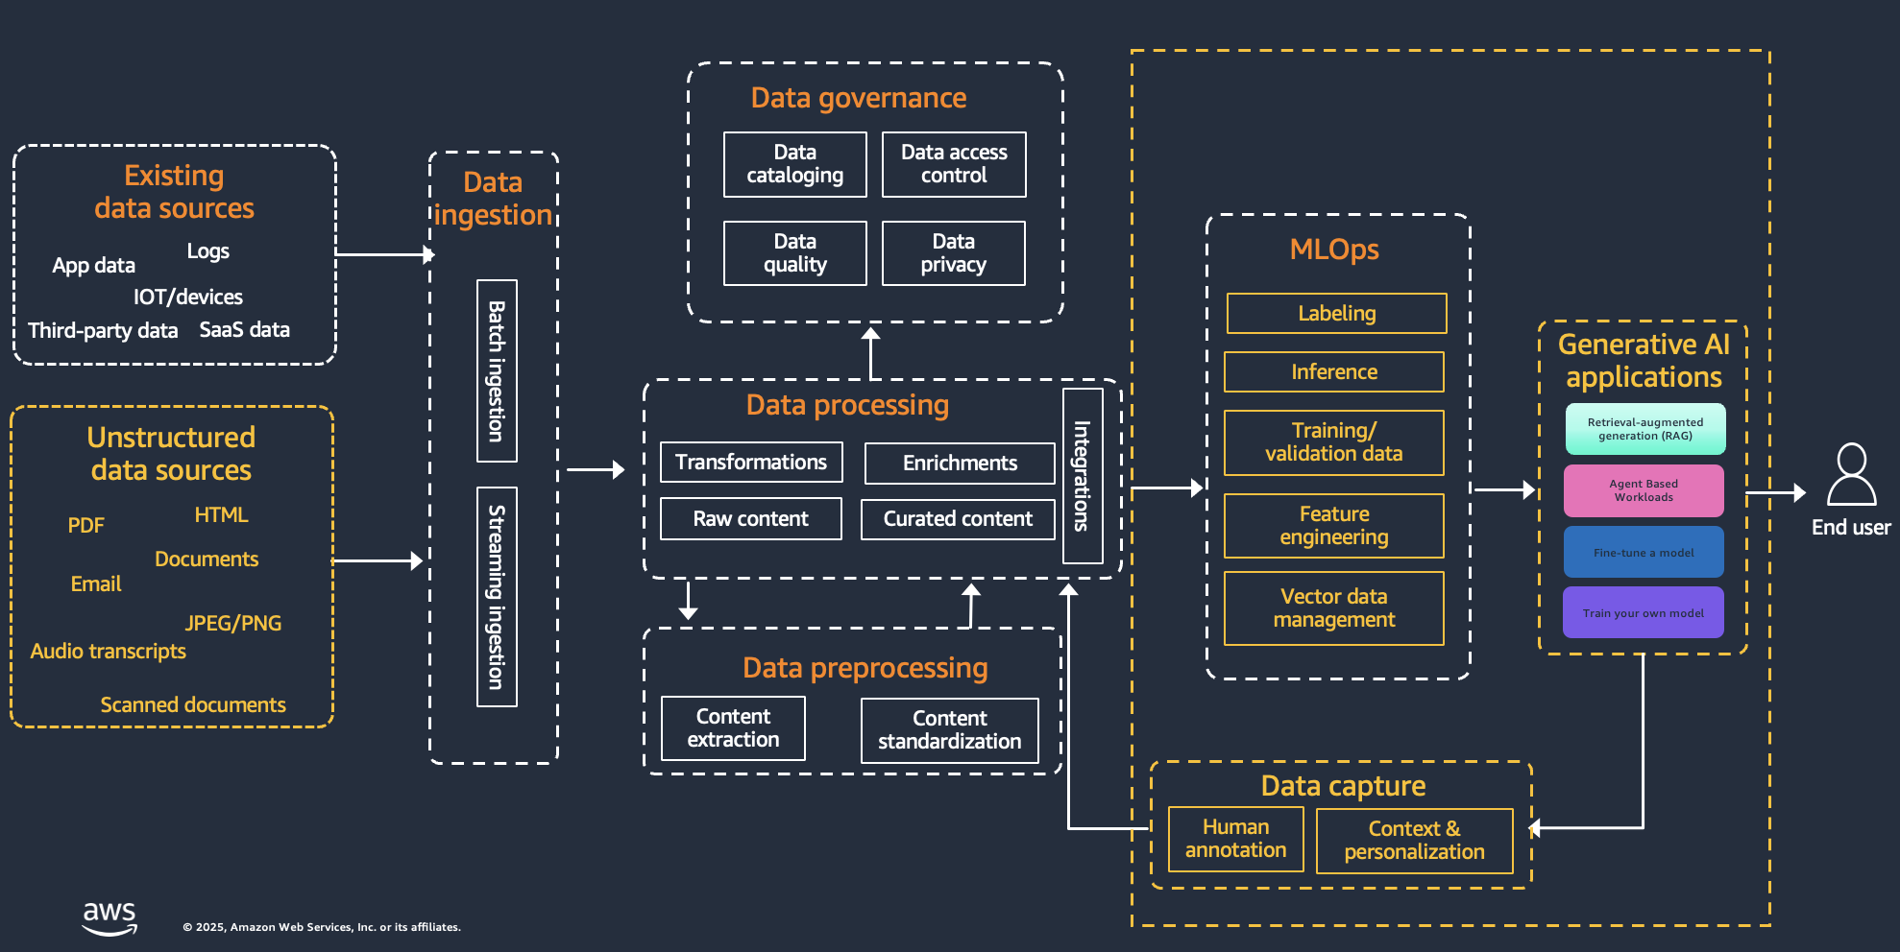
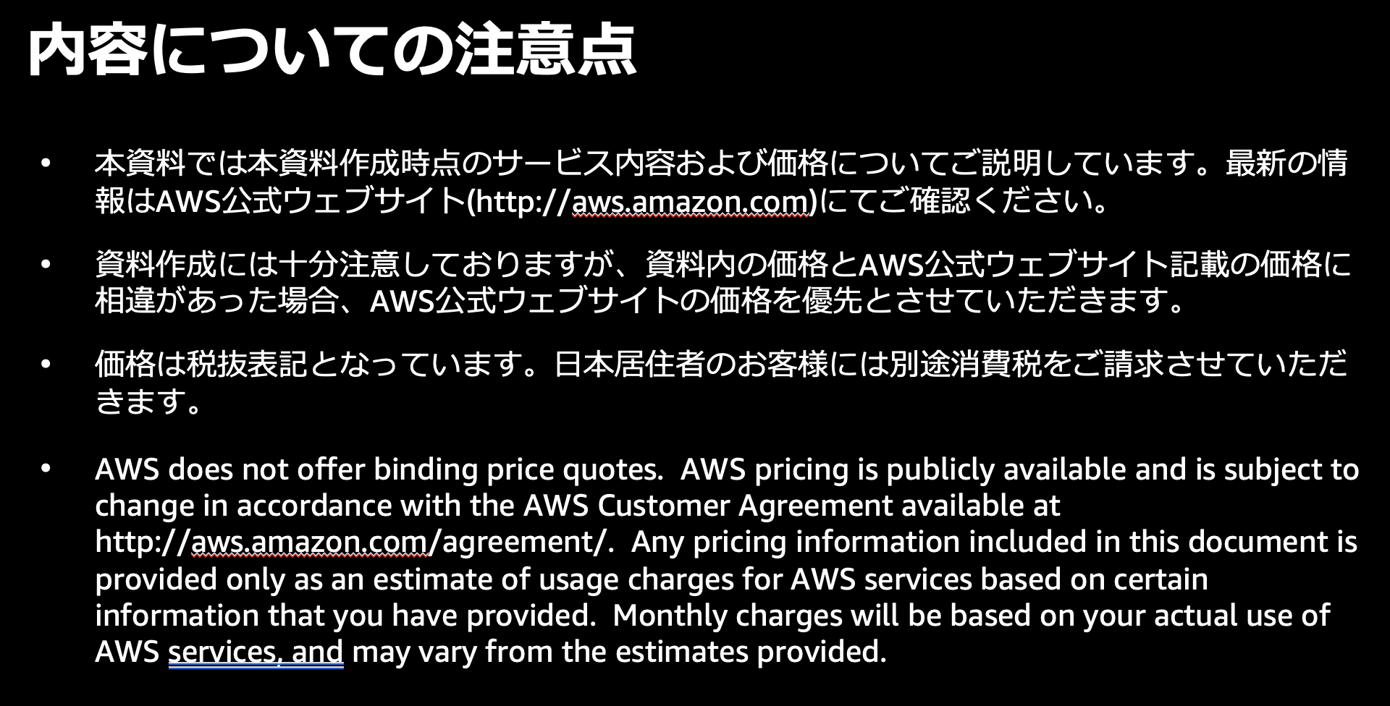
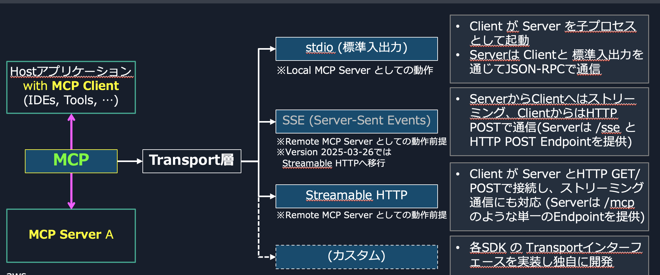
Challenges in PPT Translation
Difficulties with Retrieval
Preserving formatting
Text color
Hyperlinks
Text overflowing from boxes, etc...
People's perception: PPT translation is no big deal!
Reality?

Slide 2
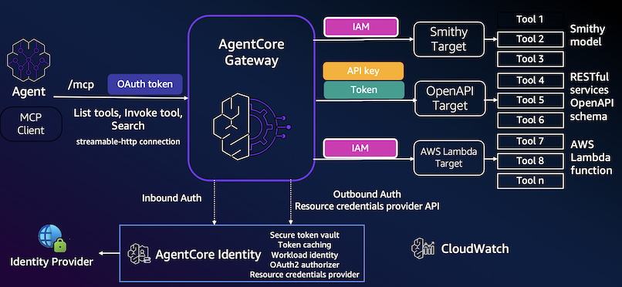
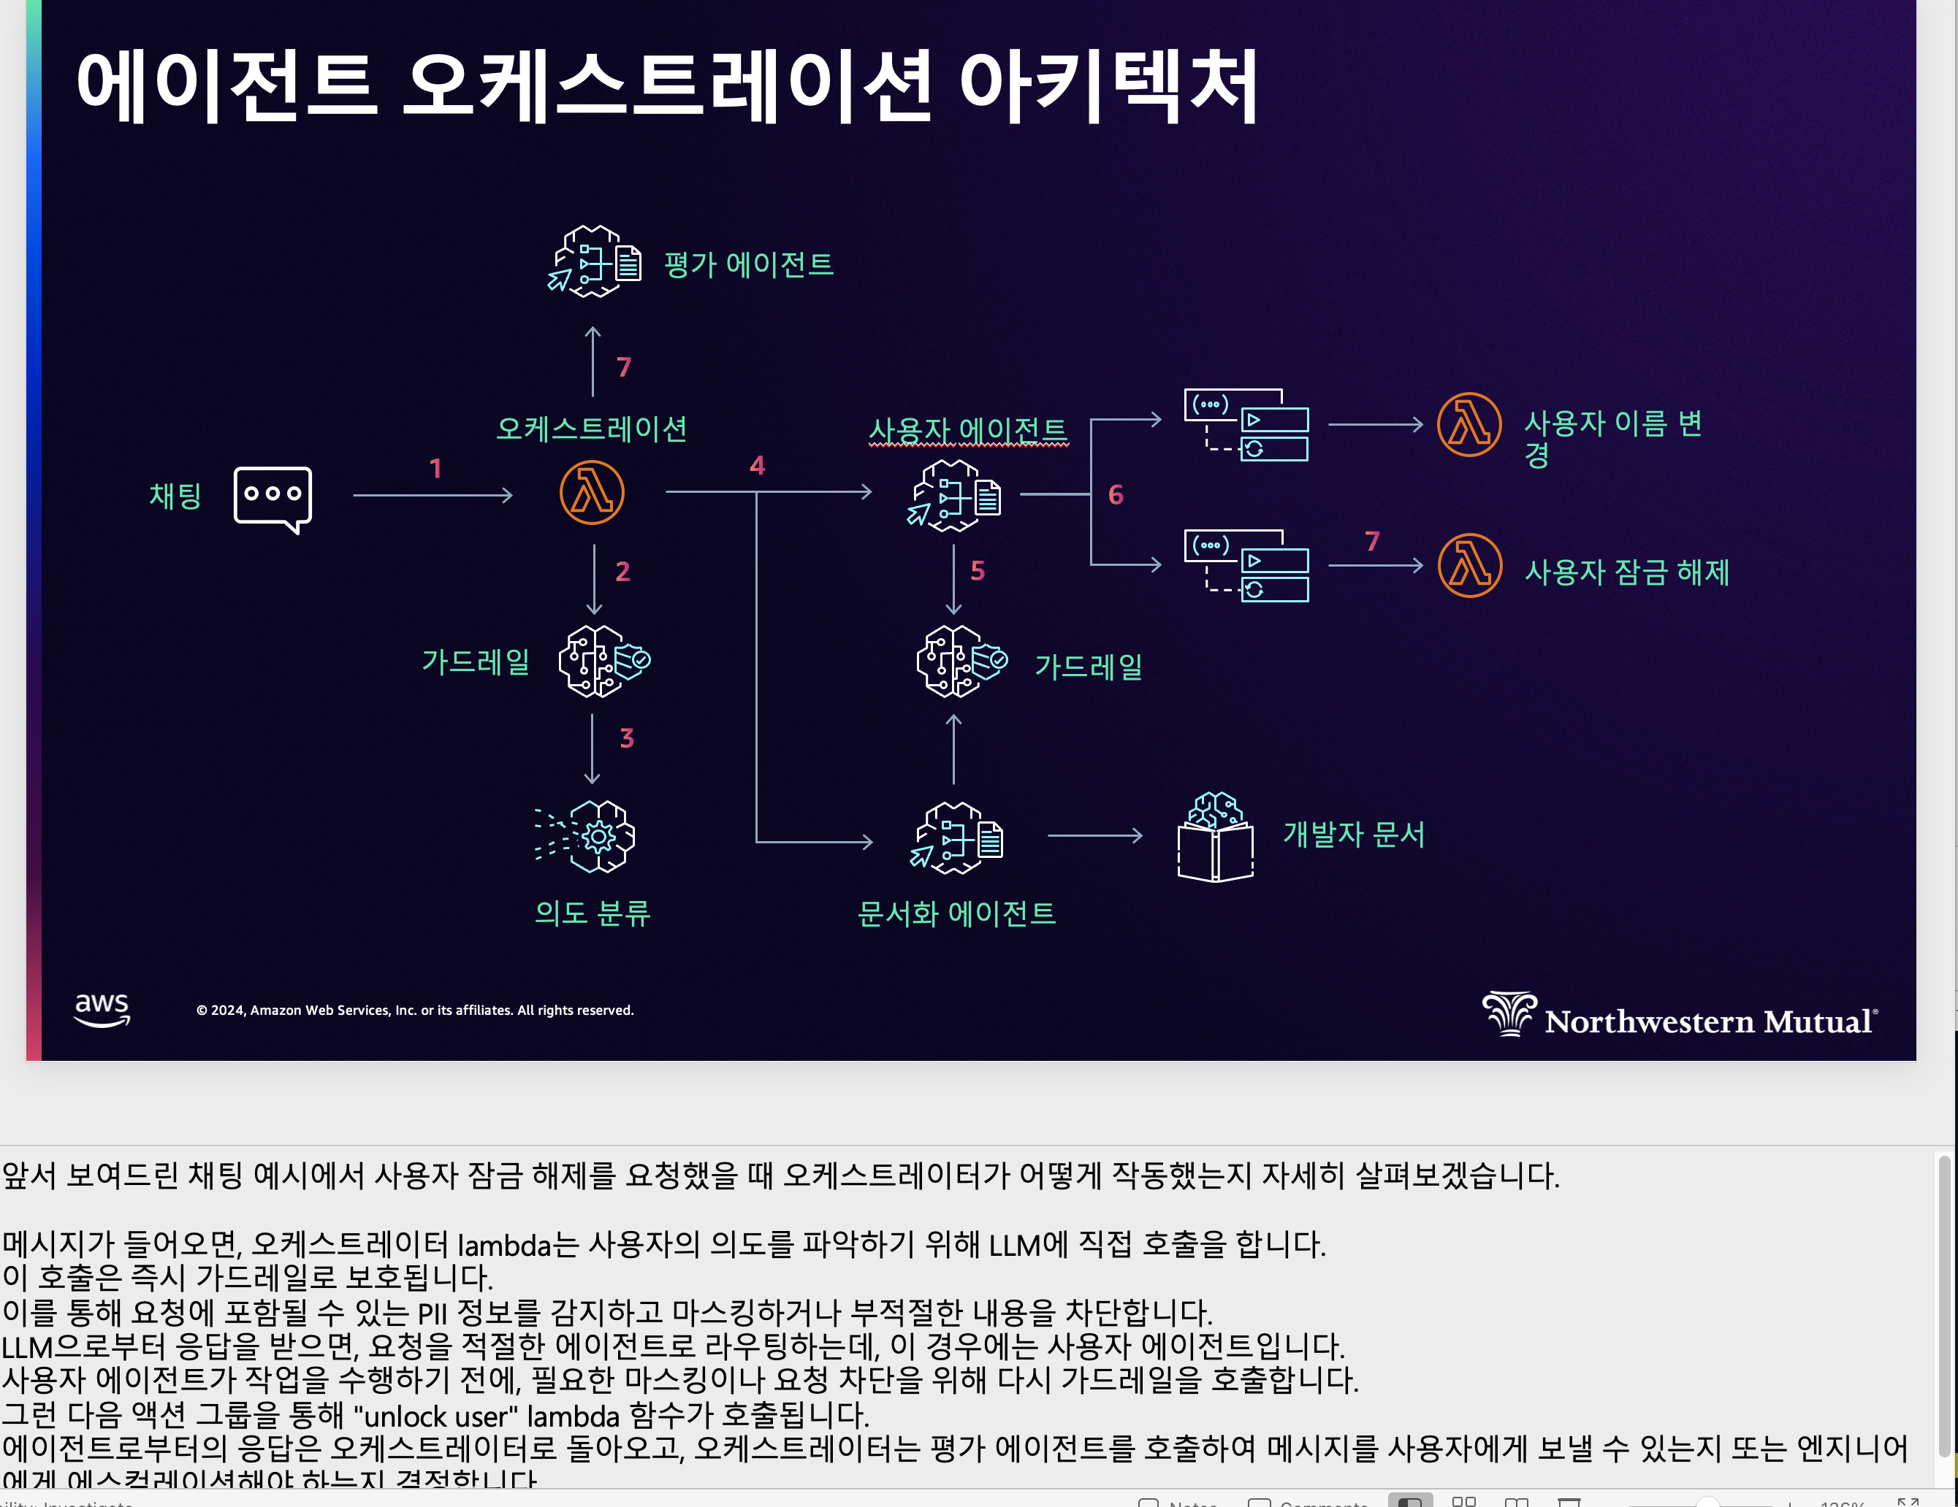
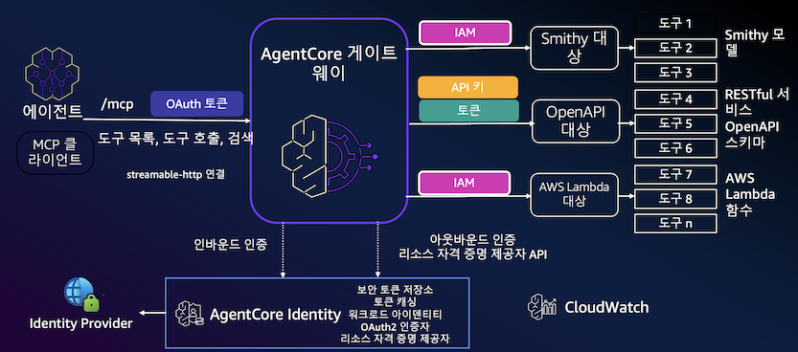
Translation Result Example
English to Korean Translation Example
Note Translation (Original: Chinese Deck)

Slide 3
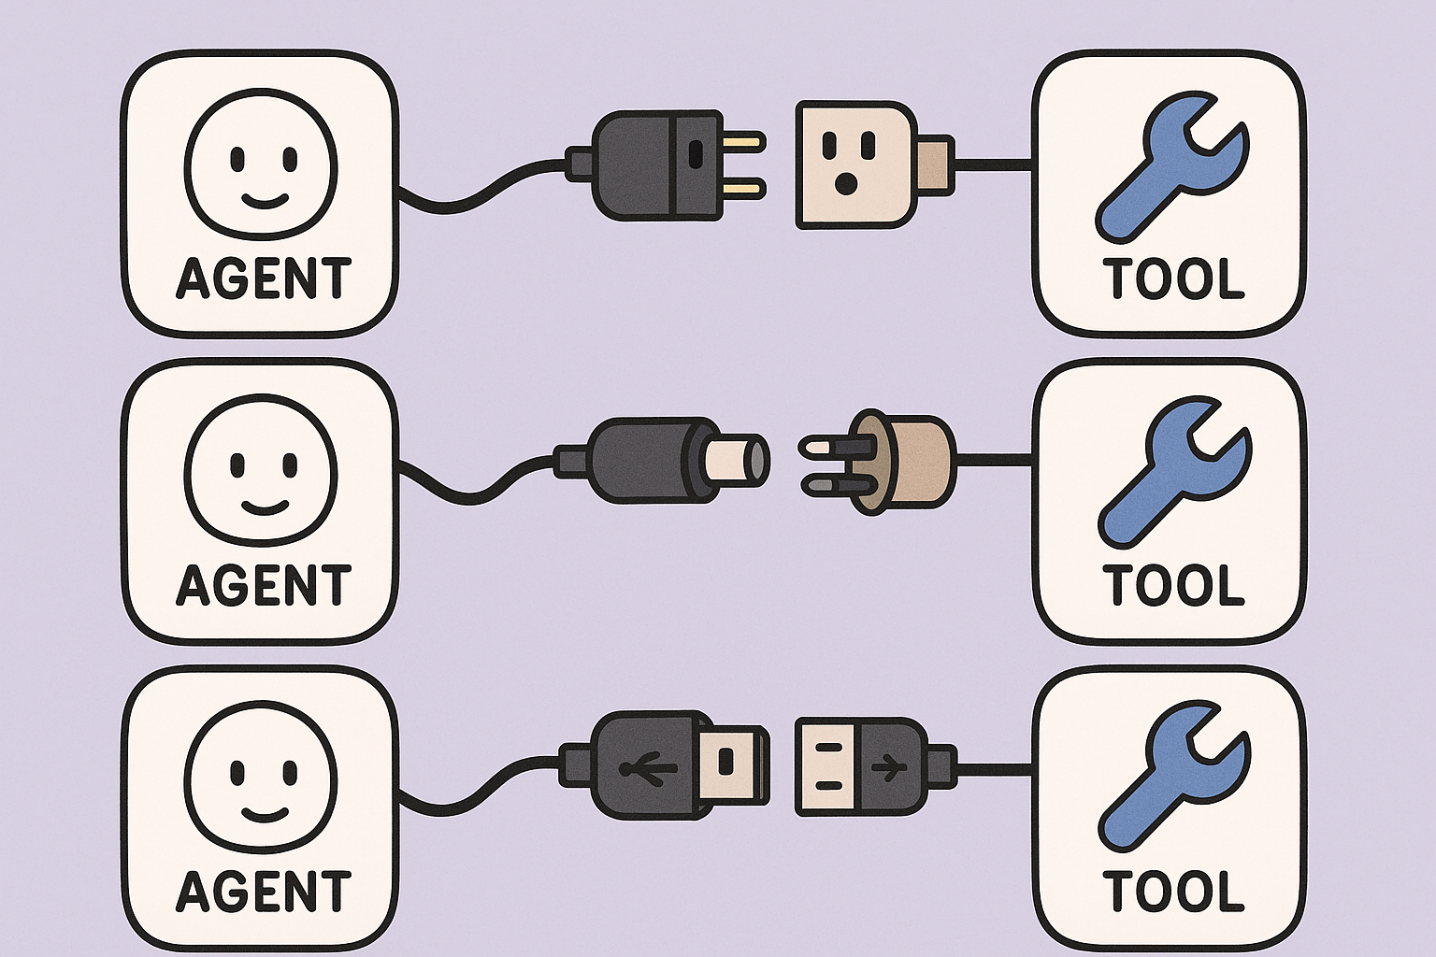
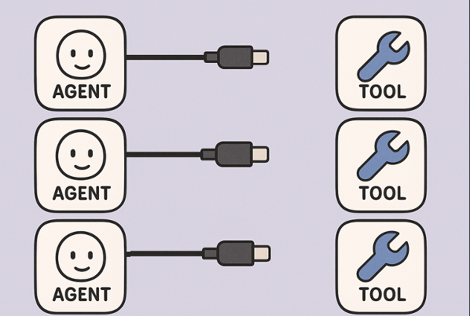
Without MCP vs. With MCP (Easy Version)
The methods of connecting AI and tools are all implemented in their own way depending on the language, developer, library, and service
Every time you connect LLM and tools, effort goes into the connection work - developer friendly
A unified standard for connecting AI and tools is prepared
If everyone creates AI apps or tools according to that standard, connection becomes easier
Different connection methods for each
Everyone uses the same connection method, which is being called the USB-typeC of the agent world

Slide 4





MCP
Tools for agents
Agent A
Internet search
JSON-RPC
MCP server
MCP client
Agent B
Database or knowledge base
Tool and logic are embedded in MCP server
Agent / LLM automatically discover the tool from MCP server
Agent C

